Slide 1
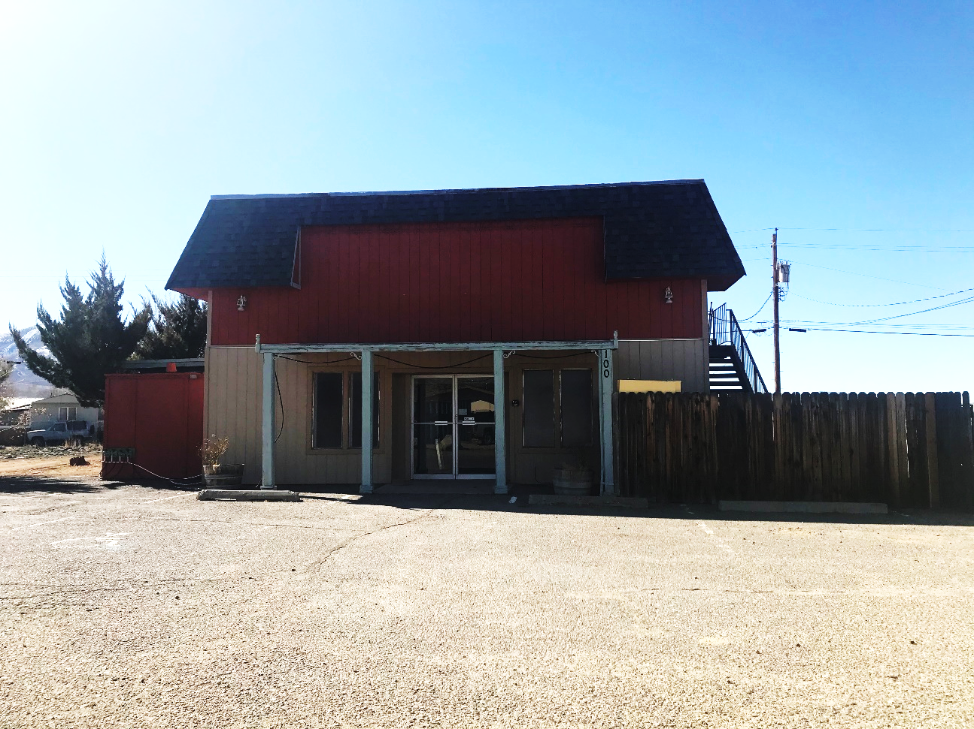
WADMIN20-0002 (Mommies & Daddies Daycare)
Washoe County Board of Adjustment
April 16, 2020

Slide 2
Request
This is a request for an administrative permit to allow for the establishment of a child daycare center that will accommodate up to 45 children from ages 0 to 12 years old
The subject property has a regulatory zone of General Commercial (GC) and Washoe County Development Code (WCC) Table 110.302.05.2 allows child daycare in GC with approval of an administrative permit

Slide 3
Background
The existing 2,932 sq. ft two- story building will have the daycare on the ground floor and the upstairs will be used for the daycare’s office
There have been different businesses in the building and the previous one was a church
The applicant indicates that there is a need for daycare facilities in the area

Slide 4
Analyst
Some of the property is landscaping, Development Code Interpretation 04-1 states that, if the building is not being expanding more than 50% the applicant is not required to meet Washoe County landscaping requirements.
The building is not be expanded and the applicant is not required to add to the current landscaping
The parking on site will need to meet the current parking requirements, which is 1 off-street parking space for every 8 students and one parking space per employee during peak hours

Slide 5
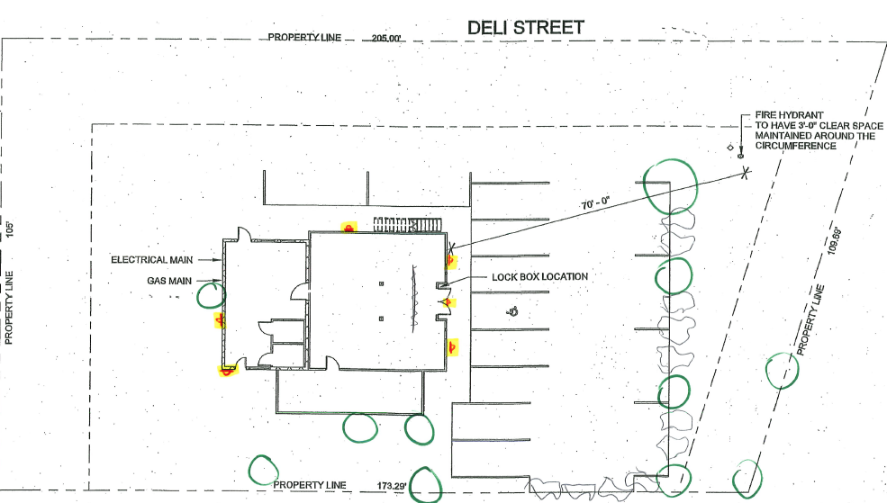

Slide 6
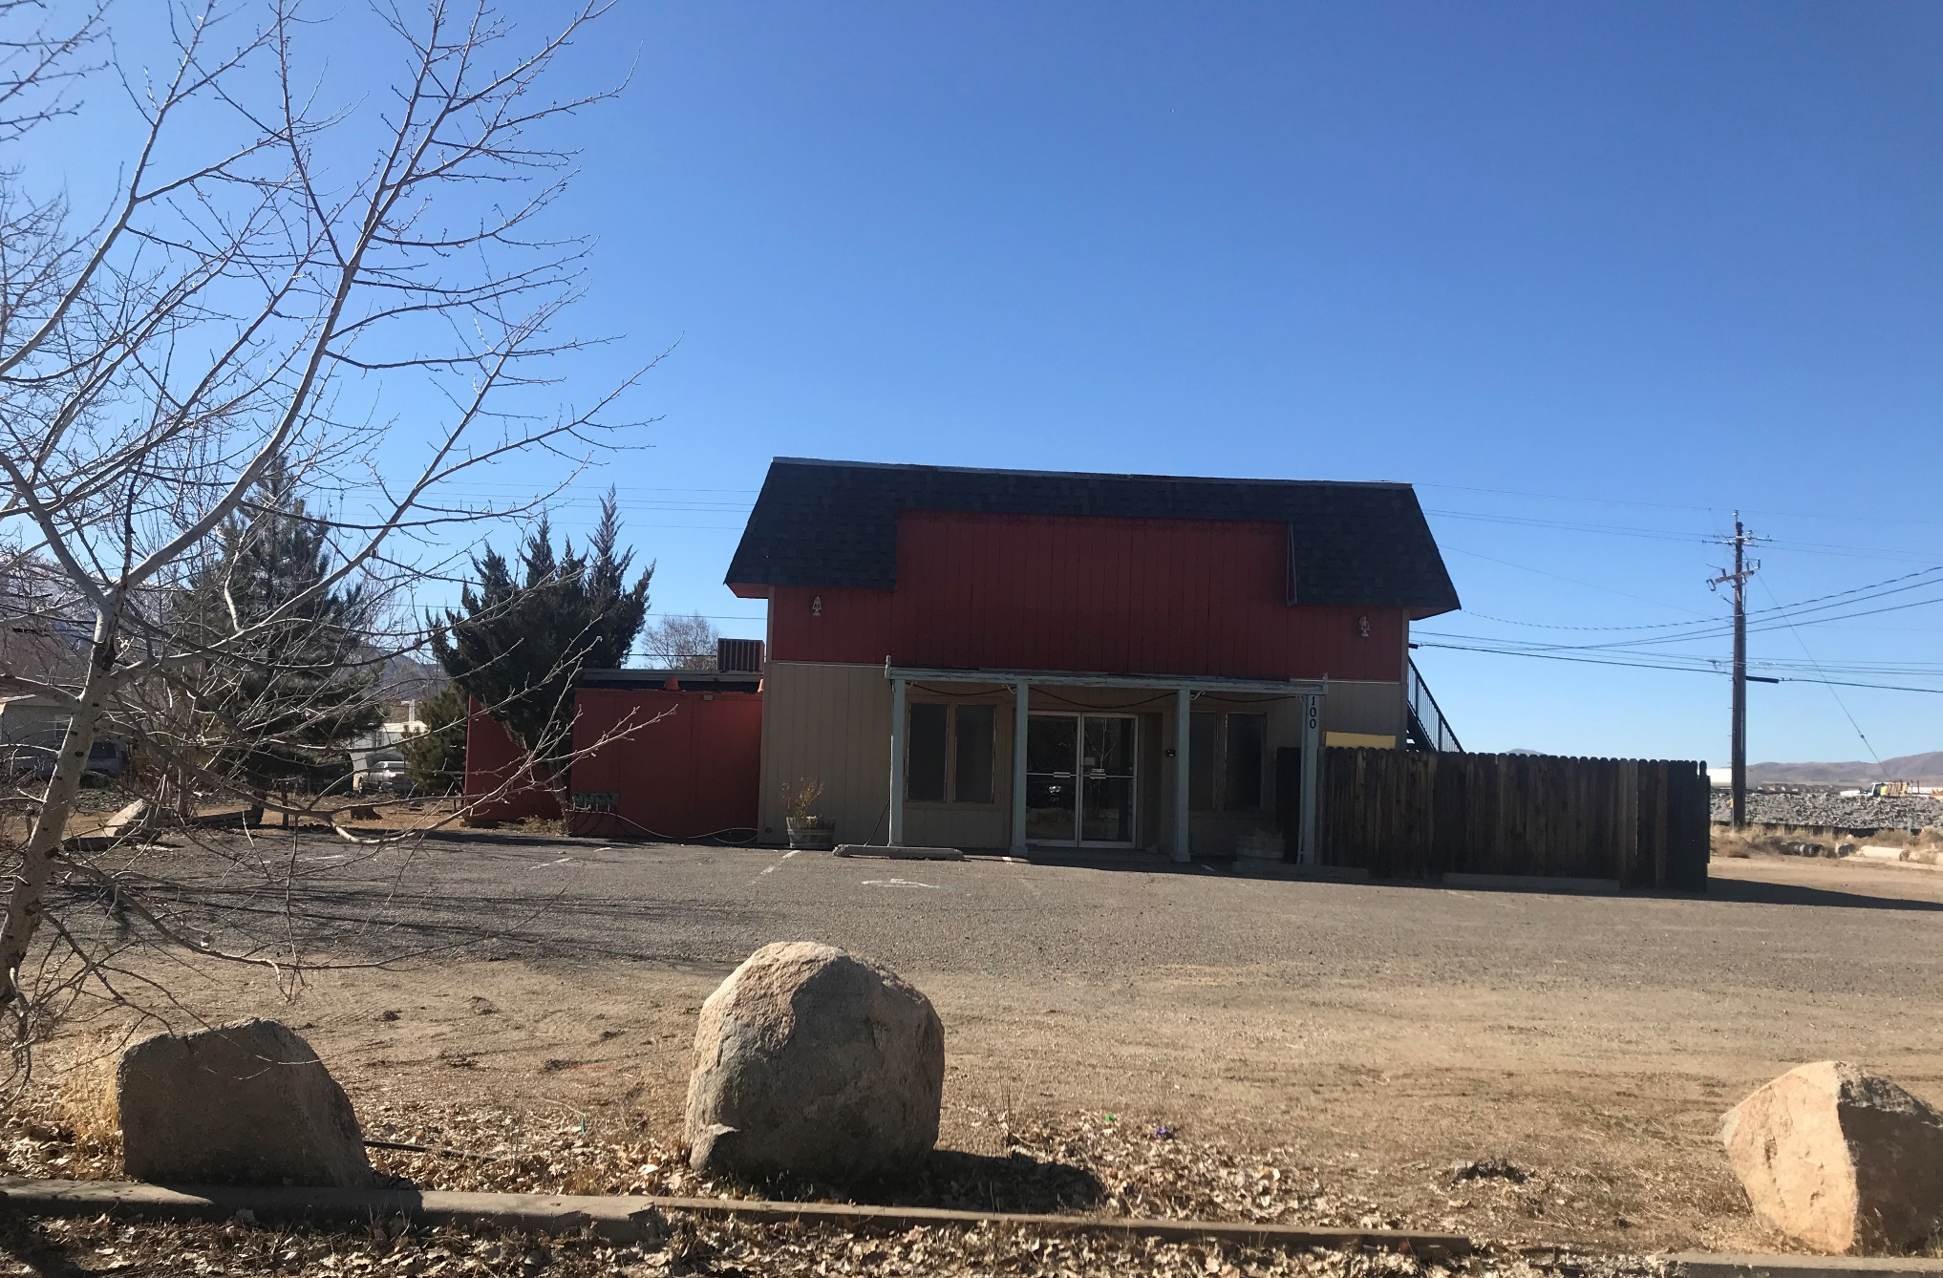

Slide 7
Public Notice and CAB
Public notice was sent to parcels within 500 feet from the site
The North Valleys CAB reviewed the application on March 9th and unanimously recommended approval of the request with very little discussion.

Slide 8
Reviewing Agencies
Various agencies reviewed the application, their comments are included in the staff report
Agencies with conditions, are included in the Conditions of Approval

Slide 9
Administrative Permit Findings
Consistency;
Improvements;
Site Suitability;
Issuance Not Detrimental; and
Effect on a Military Installation.
Staff is able to make the required findings, as shown in the staff report on page 7-8 and recommends approval

Slide 10
Possible Motion
I move that, after giving reasoned consideration to the information contained in the staff report and information received during the public hearing, the Board of Adjustment approve Administrative Permit Case Number WADMIN20-0002 for Nikole Jacob-Jones, having made all five findings in accordance with Washoe County Development Code Section 110.808.25

